Slide 1

CSE347
Information System Analysis and Design
Md Sabbir Hossain
Lecturer
Department of Computer Science and Engineering Faculty of Science and Engineering

Slide 2
Topic
Use Case Diagram

Slide 3
What is Use Case
A formal way of representing how a business system interacts with its environment
Illustrates the activities that are performed by the users of the system
A scenario-based technique in the UML
A sequence of actions a system performs that yields a valuable result for a particular actor.

Slide 4
Use Case
Use case diagrams describe what a system does from the standpoint of an external observer. The emphasis is on what a system does rather than how.
Use case diagrams are closely connected to scenarios. A scenario is an example of what happens when someone interacts with the system.

Slide 5
Use Case Analysis
Actor:
A user or outside system that interacts with the system being designed in order to obtain some value from that interaction
Use Cases describe scenarios that describe the interaction between users of the system (the actor) and the system itself.

Slide 6
Use Cases for a medical clinic
A patient calls the clinic to make an appointment for a yearly checkup. The receptionist finds the nearest empty time slot in the appointment book and schedules the appointment for that time slot.
We want to write a use case for this scenario.
Remember: A use case is a summary of scenarios for a single task or goal.

Slide 7
Use Cases for a medical clinic
As we read the scenario, define those people or systems that are going to interact with the scenario.
A patient calls the clinic to make an appointment for a yearly checkup. The receptionist finds the nearest empty time slot in the appointment book and schedules the appointment for that time slot.

Slide 8
Questions for Identifying People Actors
Who is interested in the scenario/system?
Where in the organization is the scenario/system be used?
Who will benefit from the use of the scenario/system?
Who will supply the scenario/system with this information, use this information, and remove this information?
Does one person play several different roles?
Do several people play the same role?

Slide 9

Actors
An Actor is outside or external the system. It can be a:
Human
Peripheral device (hardware)
External system or subsystem
Time or time-based event
Database etc.
Whether human or not, represented by stick figure with the name of the actor
Actors are NOT a part of the system (external to the system)
A single actor may represent multiple physical users

Slide 10

Identifying Actors
A use case is a summary of scenarios for a single task or goal.
An actor is who or what initiates the events involved in the task of the use case. Actors are simply roles that people, or objects play.
So, from the previous scenario, what or who is the actor?
The actor is a Patient.
Patient

Slide 11
Use Case Component
The use case has three components.
The use case task referred to as the use case that represents a feature needed in a software system.
The actor(s) who trigger the use case to activate.
The communication line to show how the actors communicate with the use case

Slide 12
Use Case and Function
Each use case in a use case diagram describes one and only one function in which users interact with the system
May contain several “paths” that a user can take while interacting with the system
Each path is referred to as a scenario
Use Case Labelled using a descriptive verb-noun phrase represented by an oval
Such as
Make Appointment

Slide 13
Use case: Relationship
Relationship represent communication between actor and use case
Depicted by line or double-headed arrow line
Make
Appointment
Patient

Slide 14
Use case: Relationship
Boundary
A boundary rectangle is placed around the perimeter of the system to show how the actors communicate with the system.
Make Appointment
Patient

Slide 15
Use case Diagram
Make Appointment
Patient
Produce Schedule Information
Management
Record Availability
Doctor

Slide 16
Types of Relationship
Generalization
Include
Extend
<<include>>
<<extend>>

Slide 17

Components of Use case Diagram
Generalization
Relationship Represented by a line and a hollow arrow From
child to parent
Child Use Case
Parent Use Case

Slide 18
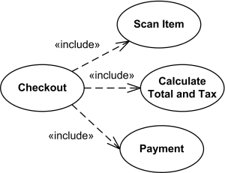
Use Case Diagram Relationship
Include Relationship
Represents the inclusion of the functionality of one use case within another
Arrow is drawn from the base use case to the used use case
Write << include >> above arrowhead line
Cashier

Slide 19
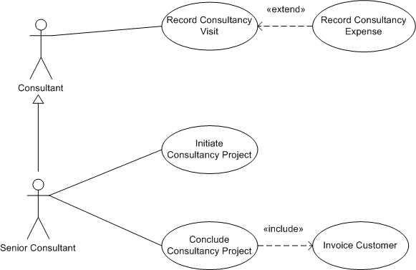
Use Case Diagram Relationship
Extend Relationship
Represents the extension of the use case to include optional functionality
Arrow is drawn from the extension use case to the base use case
Write << extend >> above arrowhead line

Slide 20
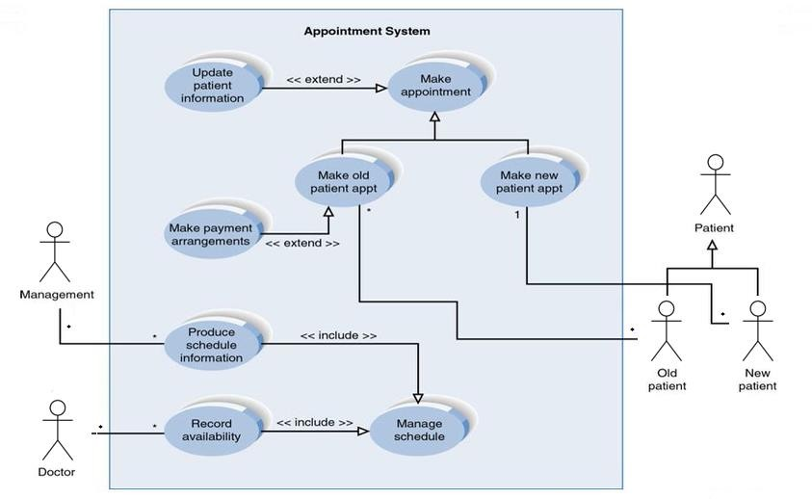
Relationship: Medical Clinic Example

Slide 21
Use Case Relationships
Pros:
Reduces redundancy in use cases
Reduces complexity within a use case
Cons:
May introduce complexity to use case diagram
Mainly talking about extend, include, and generalization relationships.
95% of relationships on a use case diagram is association

Slide 22
Benefits of Use Case
Relatively easy to write and easy to read
Comprehensible by users
Engage the users in the requirements process
Force developers to think through the design of a system from a user viewpoint
Identify a context for the requirements of the system
Critical tool in the design, implementation, analysis and testing process
Rapid change allows exploratory approach
Serve as inputs to the user documentation

Slide 23
Difficulties with Use Cases
As functional decompositions, it is often difficult to make the transition from functional description to object description to class design
Reuse at the class level can be hindered by each developer “taking a Use Case and running with it”. Since UCs do not talk about classes, developers often wind up in a vacuum during object analysis, and can often wind-up doing things their own way, making reuse difficult
Use Cases make stating non-functional requirements difficult
Testing functionality is straightforward, but unit testing the particular implementations and non-functional requirements is not obvious

